Slide 1

Exam AZ-301: Microsoft Azure Architect Design Crash Course
Tim Warner

Slide 2

Tim Warner
Based in Nashville, TN, US
MCT, MVP
Cert: timw.info/azarchcert
Twitter: @TechTrainerTim

Slide 3

If you like books…

Slide 4
Course Materials
timw.info/az301

Slide 5
Session 1 of 2 Learning Goals
Introduction
Consumption, Auditing, Monitoring Design
Accounting
Identity Design
Authentication
Authorization
Data Platform Solution Design
Relational vs non-relational databases
Data protection

Slide 6
Session 2 of 2 Learning Goals
Business Continuity / High Availability Design
ASR
Autoscaling
Load balancing
Deployment, Migration, Integration Design
IaaS
PaaS
Migrations

Slide 7
Ground rules
Azure Architect is an expert-level certification
You should already know how to deploy and configure Azure resources
This is a "crash course"
Please plan to review these materials more than once
Five-minute break at midpoint
Please ask/answer questions and provide feedback in the Q/A panel, not the group chat

Slide 8
Tim's Certification Study Pyramid
Interdependence
Content knowledge
Practical application
Test-taking skills

Slide 9
AZ-301 Exam Strategy/Tips
Does exam order matter?
What’s the difference between AZ-300 and AZ-301?
Does AZ-301 have performance-based labs?

Slide 10
AZ-301 Exam Strategy/Tips
Focus your skills accordingly:
60 percent Azure portal
20 percent Azure PowerShell
10 percent Azure CLI
10 percent KQL
Expect performance-based labs

Slide 11
AZ-301 Exam Strategy/Tips
Expect to see lots and lots and lots of JSON
Performance-based labs
Open a second tab for shell.azure.com
Don't be afraid to file an item challenge/grievance

Slide 12

Let's get to work!

Slide 13
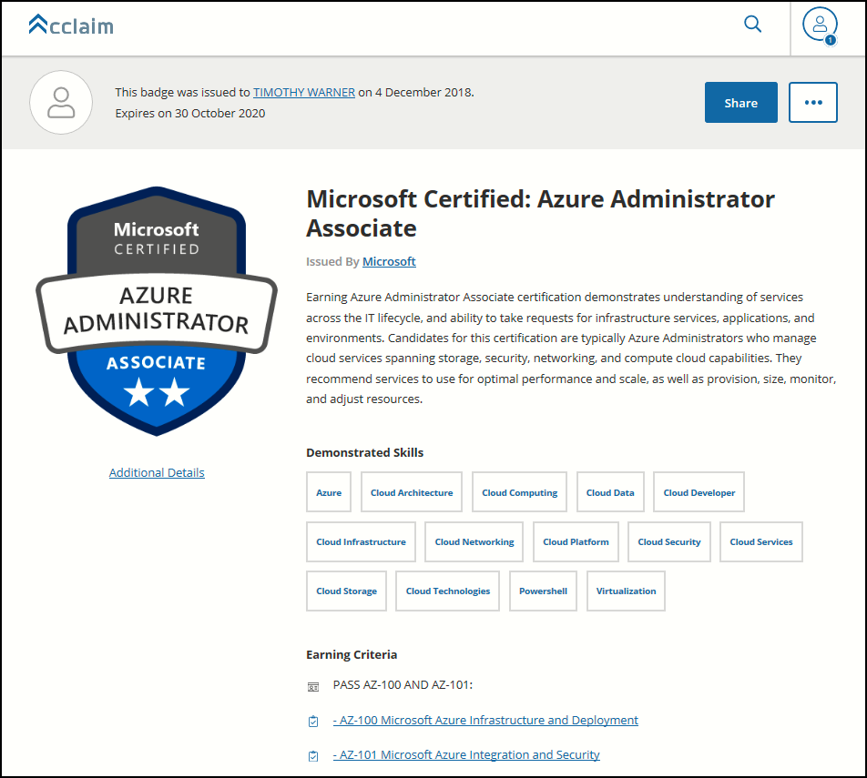
Digital Credentials by Credly/Acclaim

Slide 14
Exam AZ-301 Item Types

Slide 15
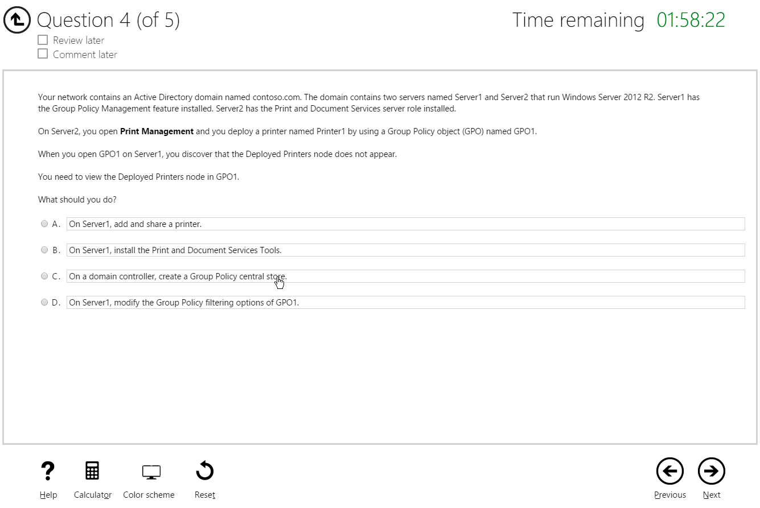
Multiple Choice

Slide 16
Repeated Scenario
You need to move an Azure VM to another hardware host.
Solution: You redeploy the VM.
Does this solution meet the goal?
Yes
No

Slide 17
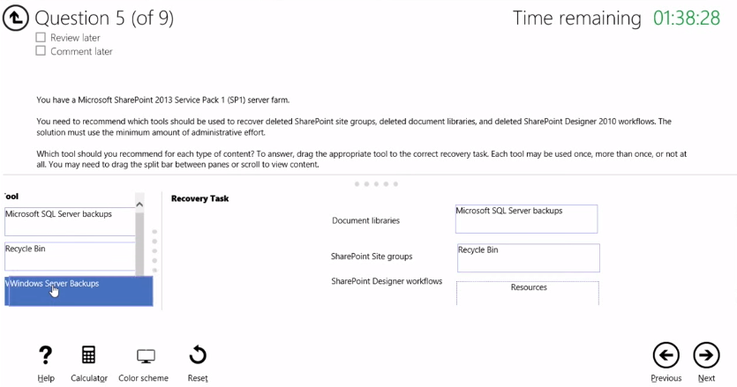
Select and Place

Slide 18
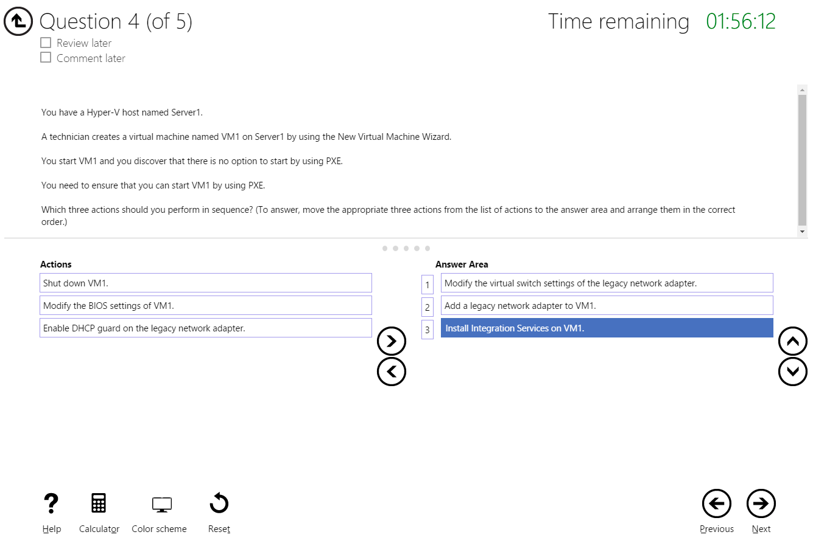
Build List and Reorder

Slide 19
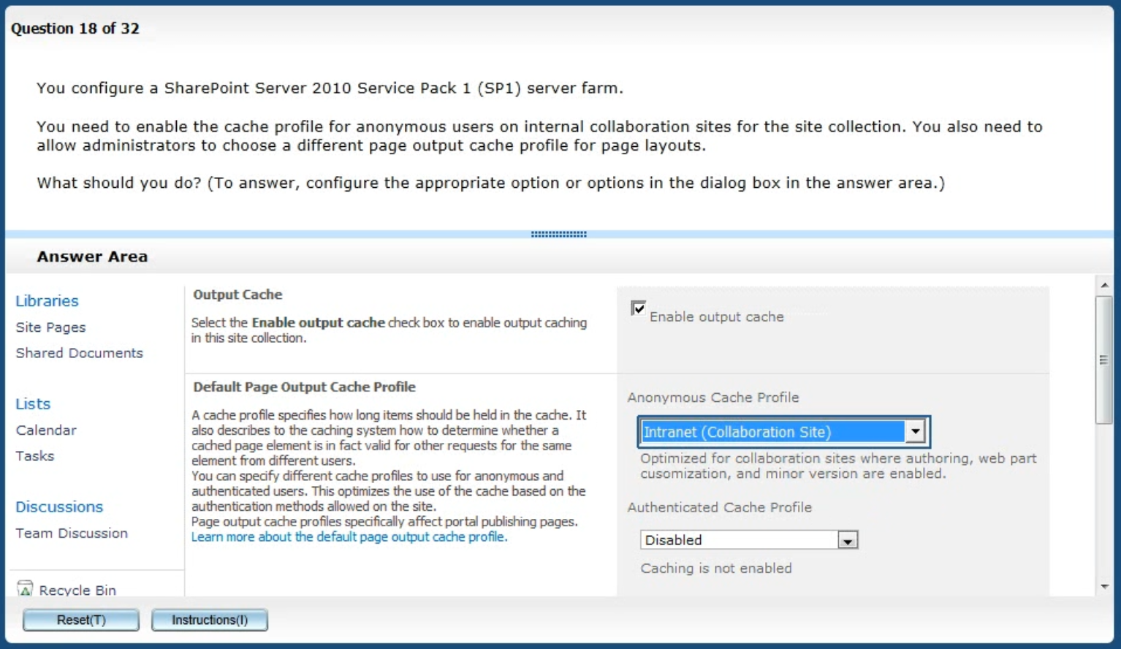
Active Screen/Fill in the Blank

Slide 20
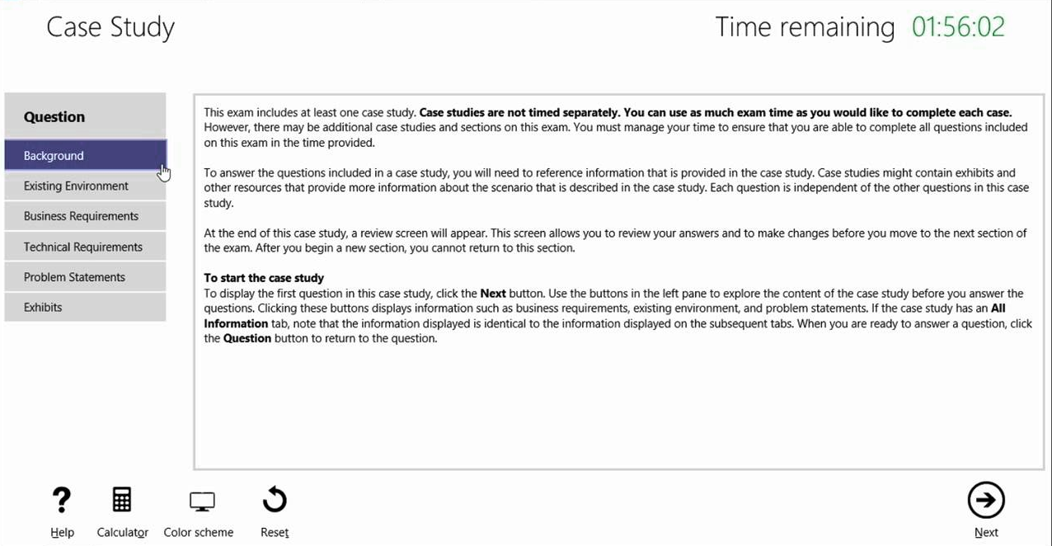
Case Study

Slide 21
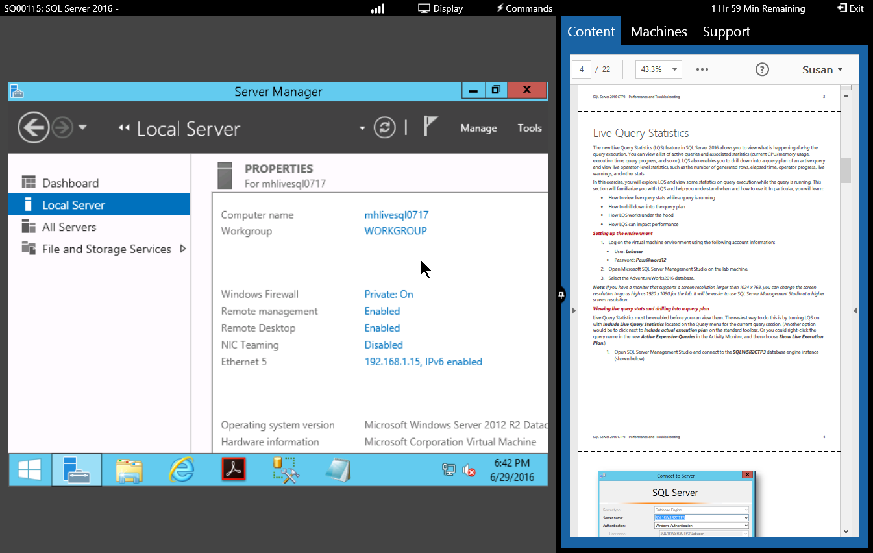
Performance-Based Lab

Slide 22
Thank you!
Course materials: timw.info/az300
Twitter: @TechTrainerTim
Work: Pluralsight.com
Web: TechTrainerTim.com

